Slide 1
AI Internship
Learning security intelligence from commit logs
Yatian Li
Supervised by Dr. Guowei Yang

Slide 2
Project Progress

Slide 3
Key messages
You can connect with your colleagues remotely via Zoom
You can access your UQ file shares remotely using the UQ VPN
You should only connect to the VPN when it is necessary
You can access a range of software applications at home including Office 365
Only take IT equipment from campus with appropriate authorisation
Do not take lab computers off campus
Do not download UQ files to a USB or similar
Keep cyber security in mind

Slide 4

Before you work from home
Make sure you have approval to take any UQ IT equipment off campus
Staff should be working on UQ laptops or personal computers and should not take desktop or lab computers off-campus.
If it is absolutely necessary to take a desktop computer to work remotely, first ensure you have:
Installed UQ’s VPN software
Have all the necessary components (e.g. mouse, keyboard, network cable, monitors, microphone and speakers) to work remotely
Check that you have all the necessary software on your UQ computer before taking it from campus

Slide 5

Before you work from home
If you’re using a personal computer:
Check that you’ve installed the most recent version of your operating system
Ensure anti-virus software is installed and up to date
Ensure that your home internet connection is stable and fast enough to complete your work reliably
Submit a support request with any outstanding IT issues or queries you have

Slide 6
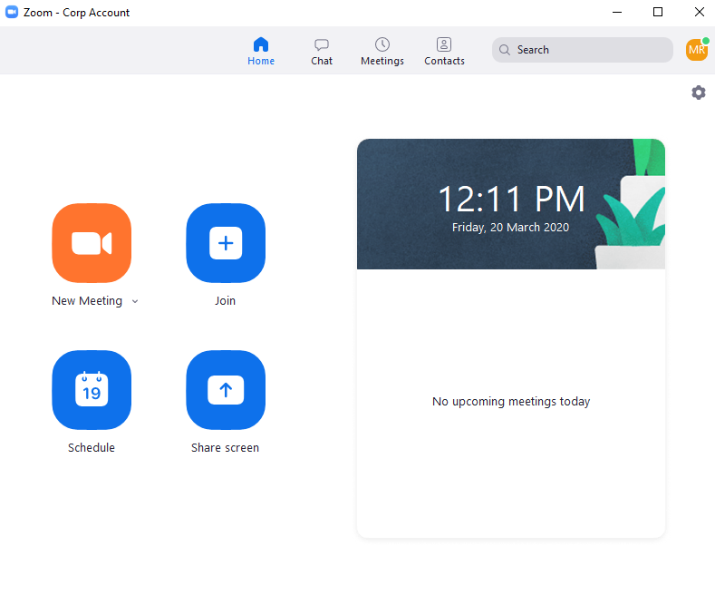
Communicate with colleagues
All staff and students can use Zoom to communicate with colleagues.
You can use Zoom to:
Chat with colleagues
Organise and attend video conferences
Schedule recurring meetings
Dial into meetings via phone
Share your screen with others
Follow the Zoom guides to install and use Zoom.
If you experience performance issues with Zoom, consider swapping to audio only and ensuring you’re not connected to the VPN unless required.

Slide 7
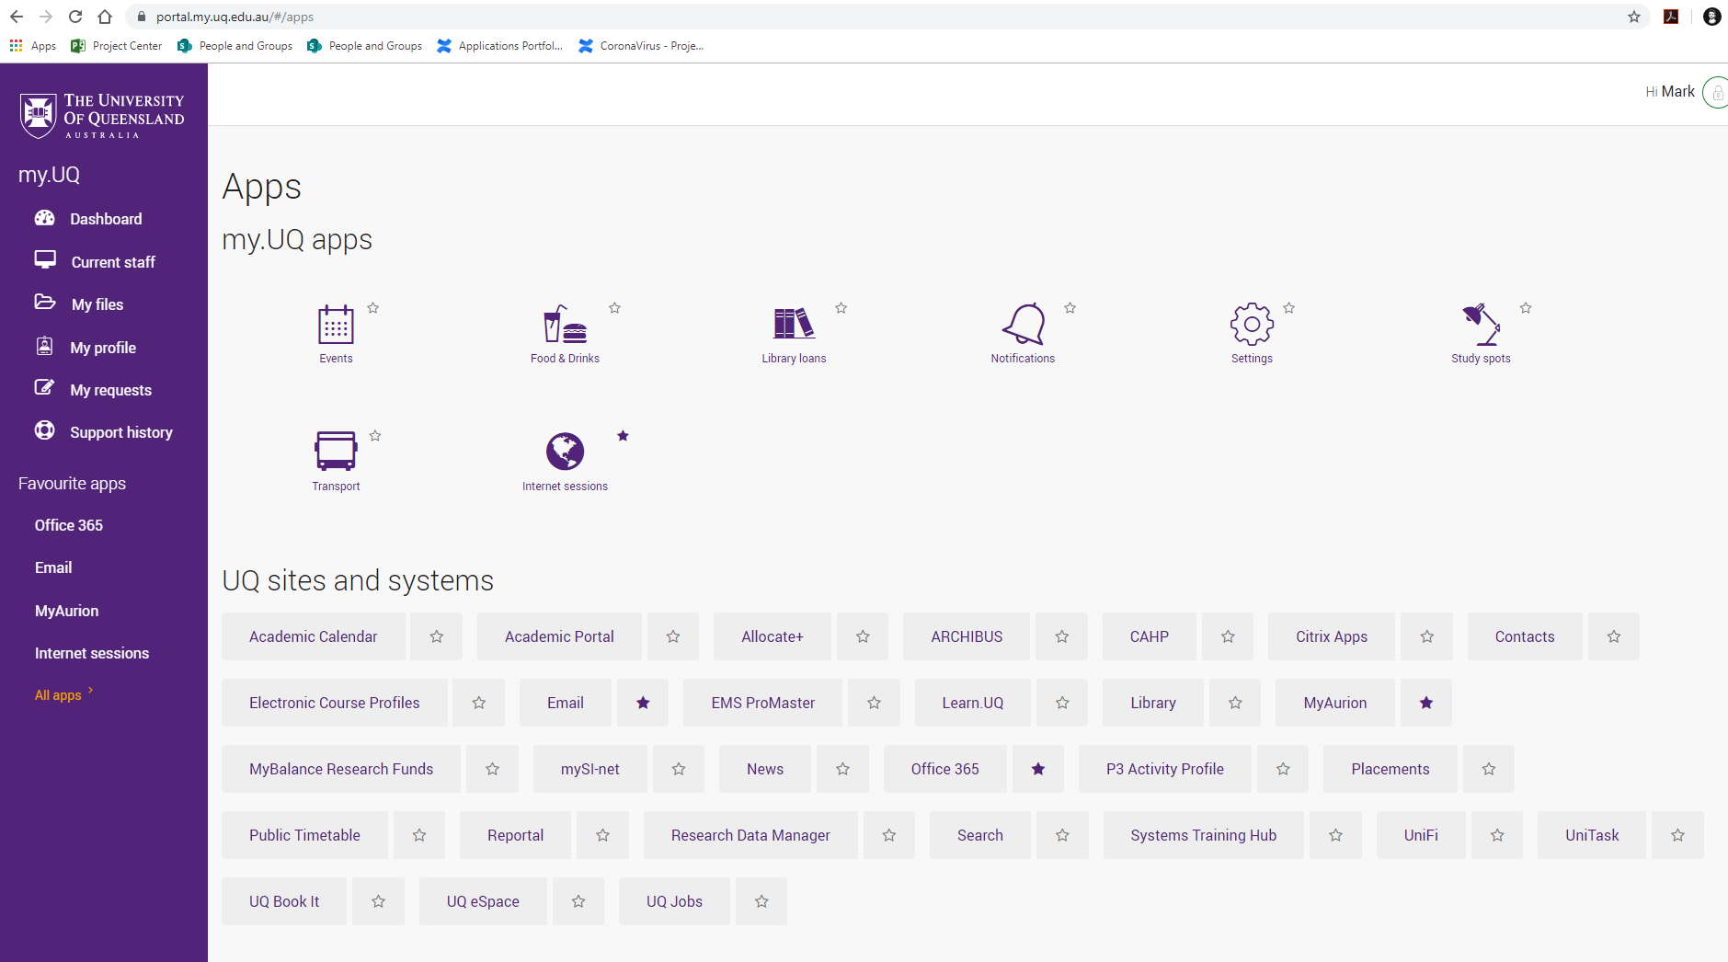
Remote access to UQ’s core systems
You can access most UQ systems over the Internet without the need for additional software.
You can find quick links to core UQ systems (e.g. Email, MyAurion, Office 365, ARCHIBUS and more) by visiting the my.UQ Apps page.
Staff can also access a range of Citrix applications from home (e.g. Aurion, Raisers Edge and SiPass), via web browser – see instructions.

Slide 8
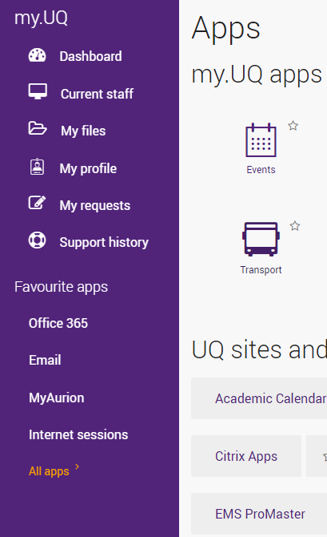
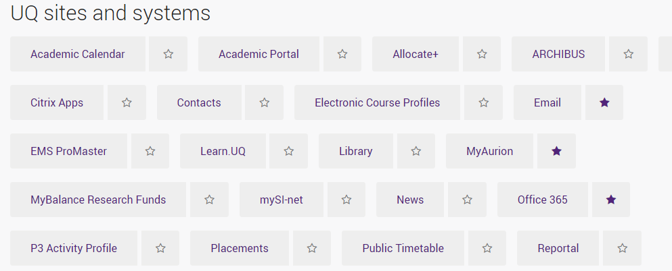
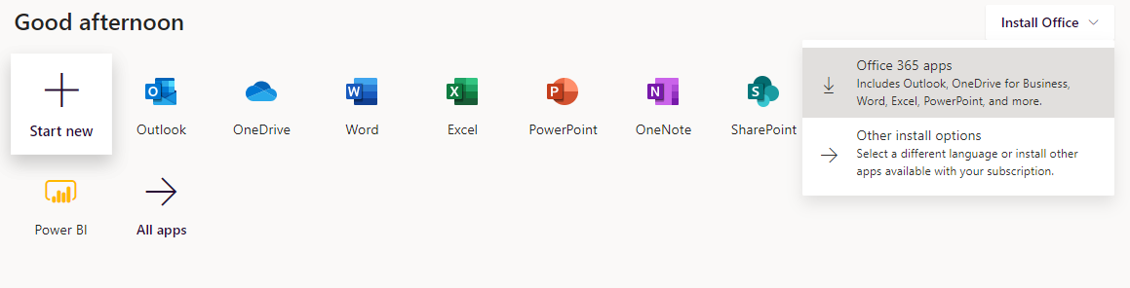
Remote access to Office 365
You can also download Office 365 to your home computer with the following steps:
Log into the my.UQ portal with your staff username and password.
Click All apps in the bottom left corner of your screen
Click Office 365
Click Install Office
Click Office 365 apps
Your download will start automatically, simply click the downloaded file and follow the instructions to install.
3
4
5
2

Slide 9
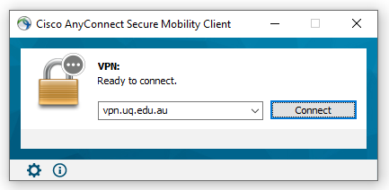
Remote access to UQ files
VPN Tips
Make sure your connection address is vpn.uq.edu.au before clicking Connect
Log into the VPN with your staff username and password
Save your files regularly
You may need to disconnect from the VPN before you can print to your home printer
All staff can use Microsoft OneDrive with 1TB of storage over the Internet. Follow the installation guide or simply access OneDrive via web browser. OneDrive does not require the Virtual Private Network (VPN)
To connect to your home drive and UQ’s shared folders (network drives) remotely, you will first need to connect to the VPN.
Follow the user guides to connect to the Cisco AnyConnect VPN and access your files.
When you’ve finished accessing your UQ files please disconnect from the VPN by opening the Cisco AnyConnect software and clicking Disconnect
Note – you should only be connected to the VPN when it is necessary. You do not need to be connected to the VPN to access UQ systems including Email, Office 365, Zoom and MyAurion.

Slide 10
Working with University information
When working remotely, staff should remain aware of the University’s legislative obligations and policies.
Ensure confidential or private information is accessed and managed accordingly
Do not move UQ files to non-UQ storage solutions like Dropbox or USB drives. UQ files can be stored on UQ file shares, OneDrive and AARNET CloudStor.
Ensure you have anti-virus software installed on your computer
Be mindful of cyber security risks such as phishing emails, particularly those relating to the COVID-19 pandemic

Slide 11
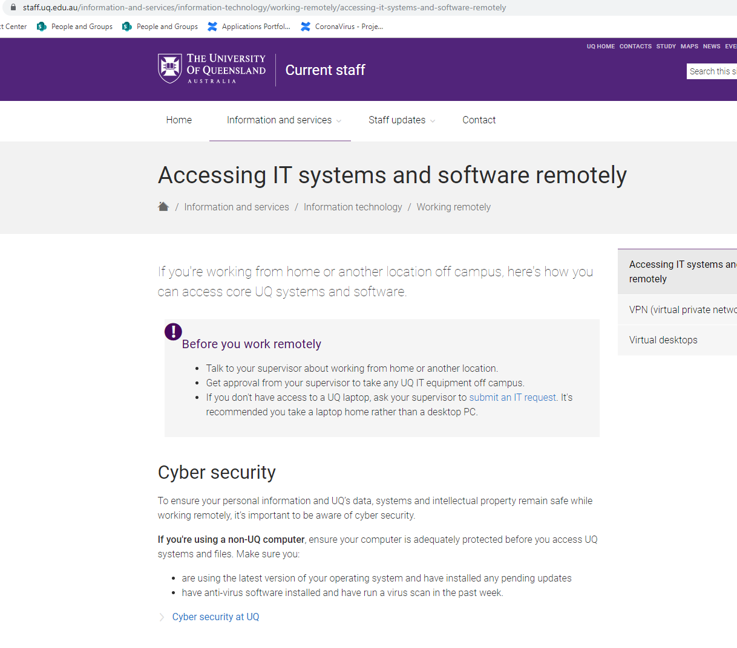
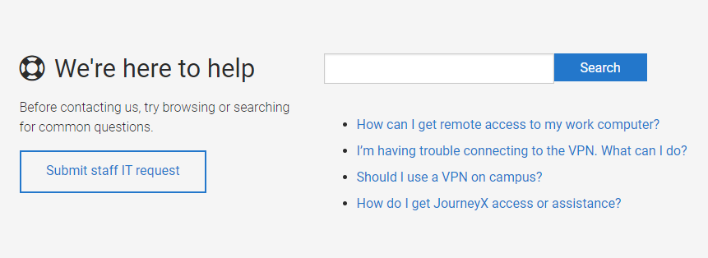
Where to get help
View the Accessing IT systems and software remotely page for information and links to helpful user guides.
Please keep in mind that remote IT support can be limited. If possible, submit your support requests and queries before leaving campus.
For urgent support contact the ITS Service Desk on (07) 3365 6000

